Slide 1
IOT BASED PRECISION FARMING
WEEKLY REPORT

Slide 2
AS PER THE LATEST ARCHITECTURE THE FOLLOWING SENSORS ARE TO BE INTEGRATED:
pH (got)
Nitrate (not got)
N,P,K (not got)
AEROPONICS

Slide 3
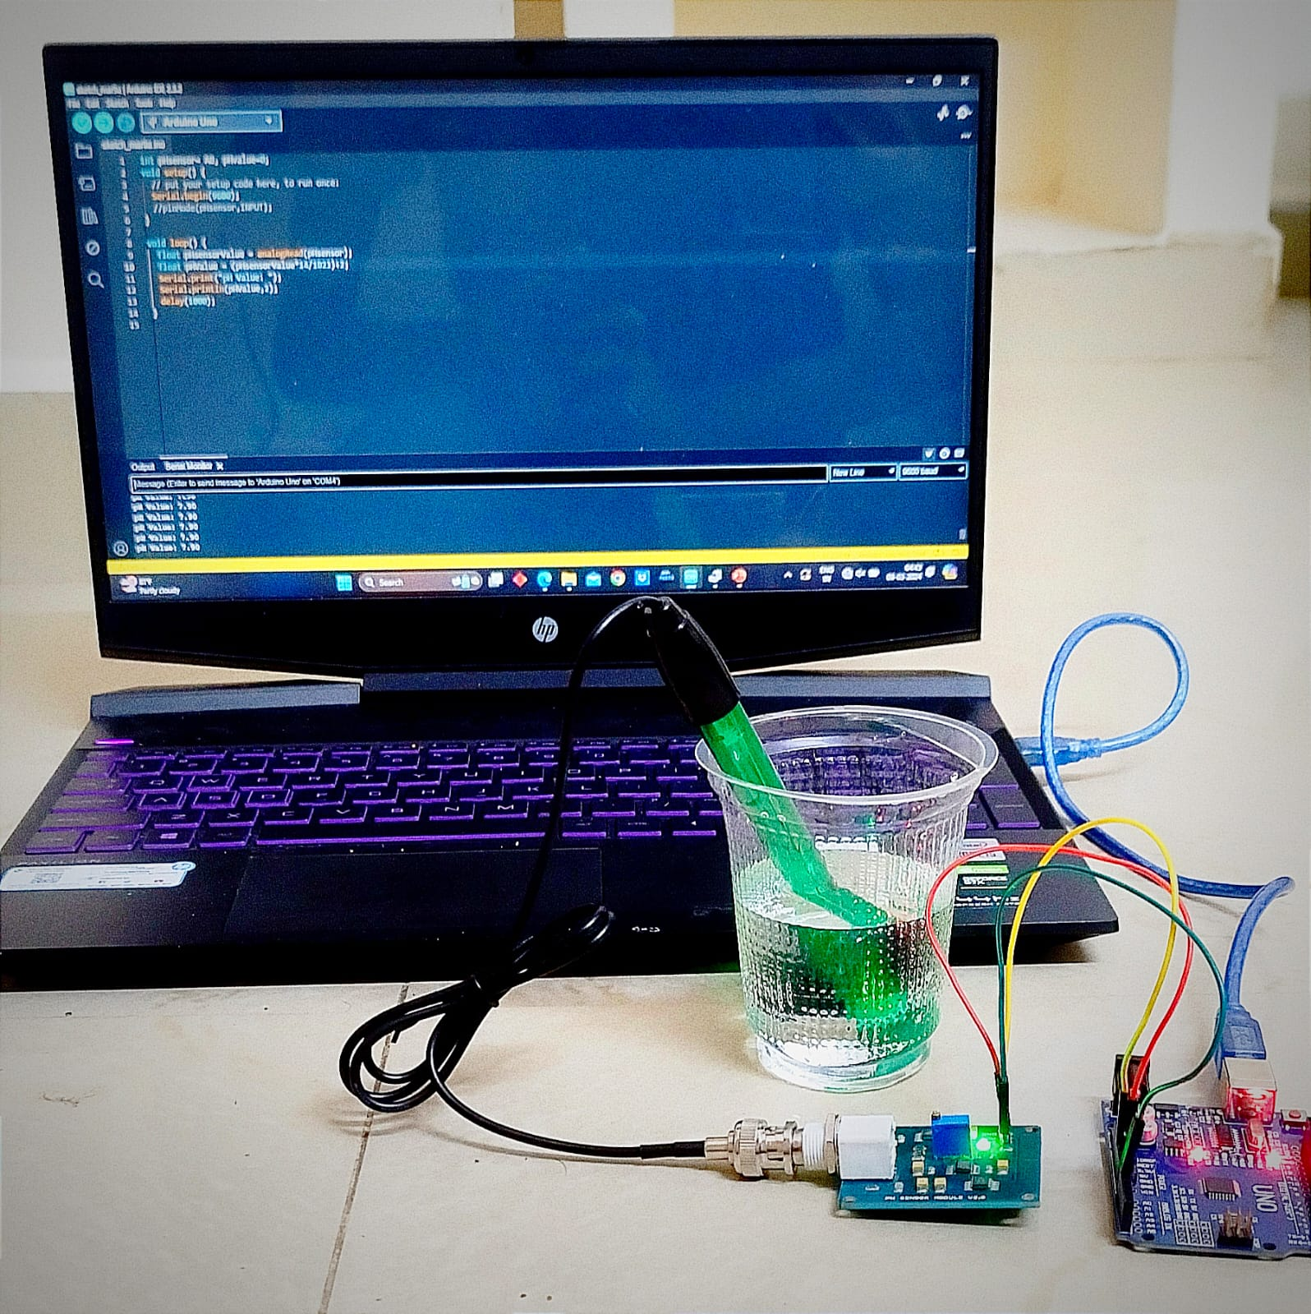
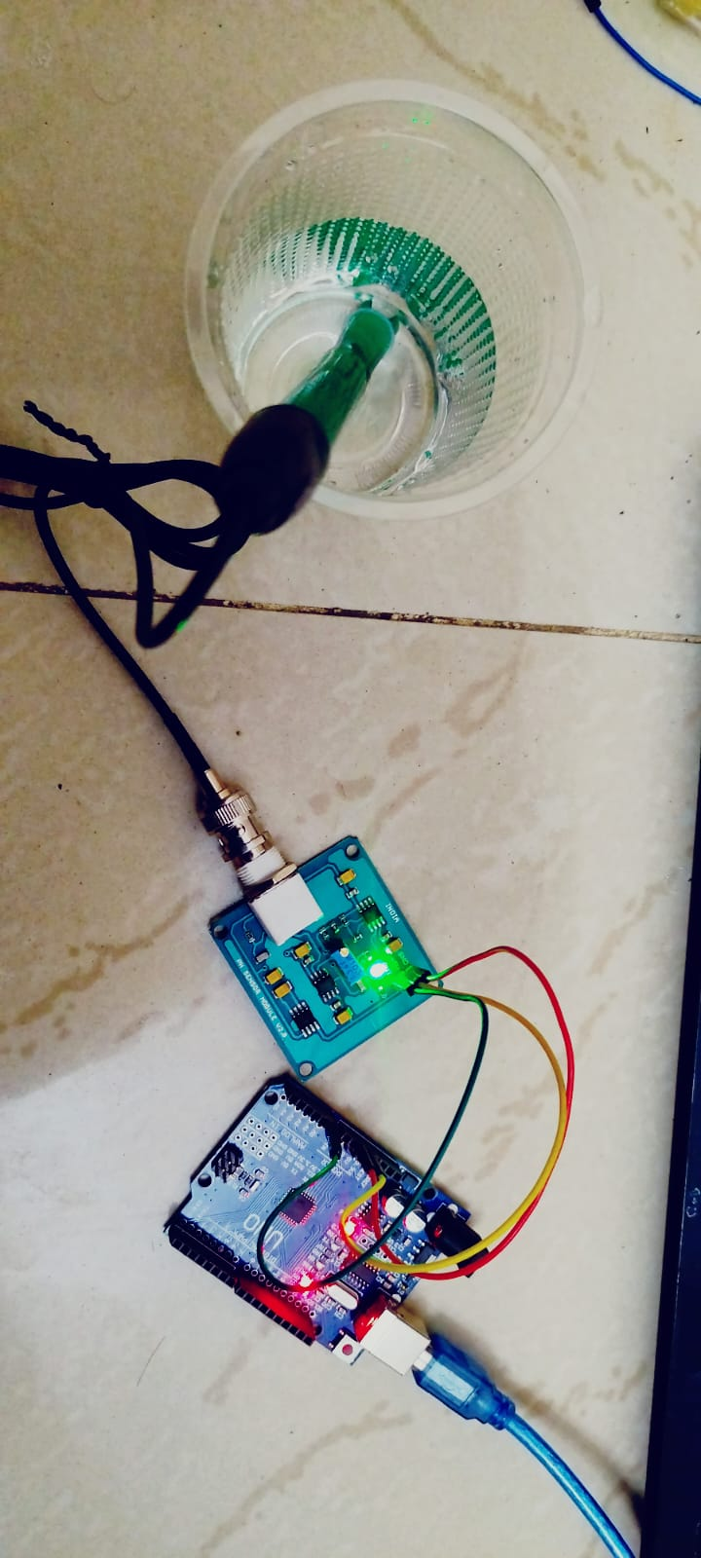
7th March,2024
pH sensor is ca
librated, tested and produced output.

Slide 4
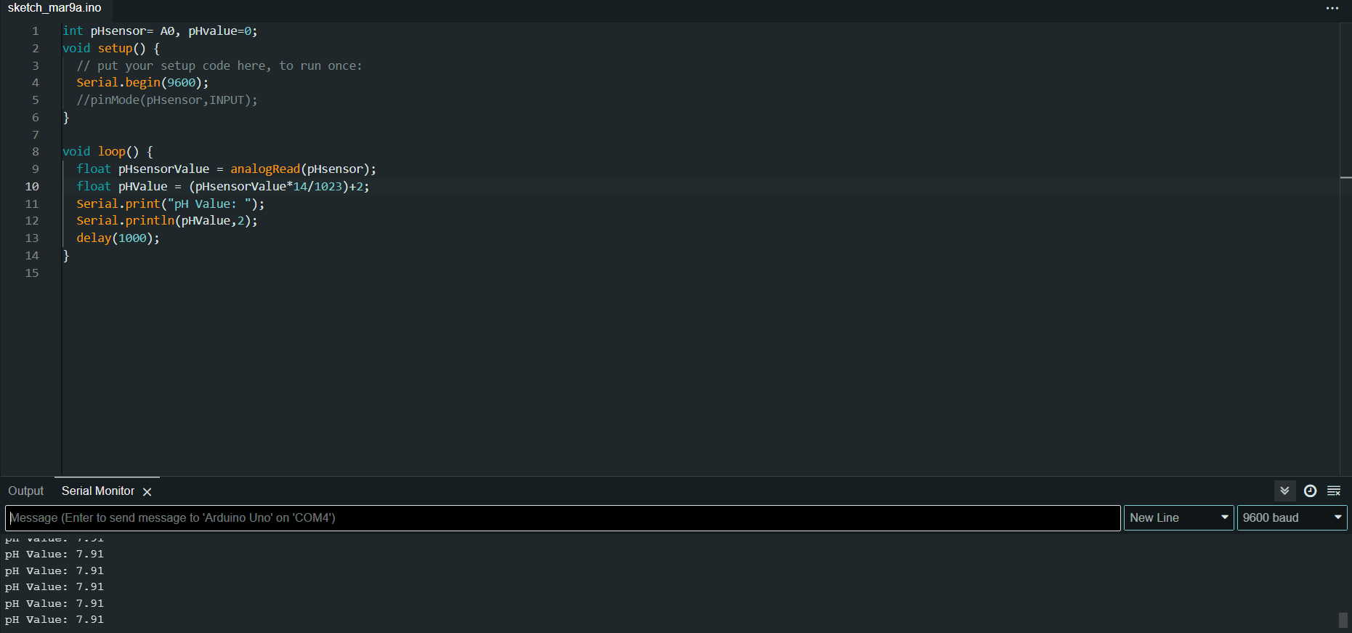
CODE AND OUTPUT FOR TAP WATER

Slide 5
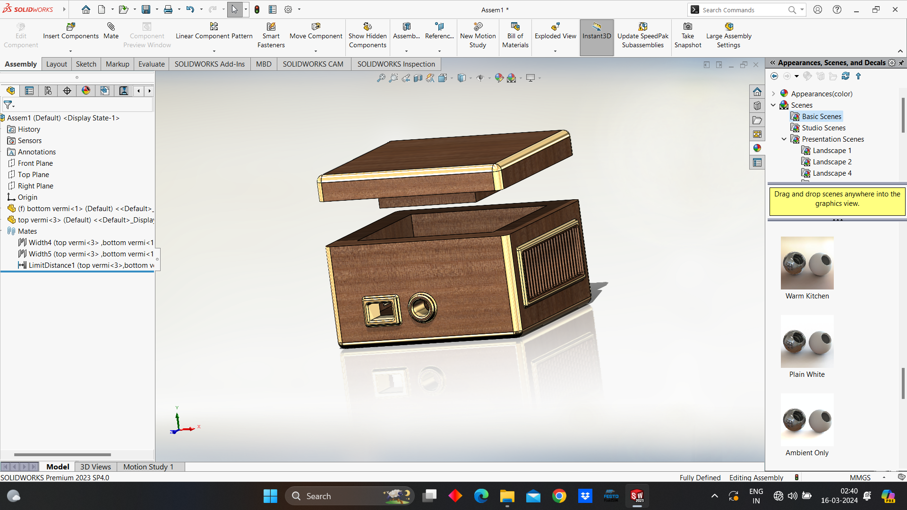
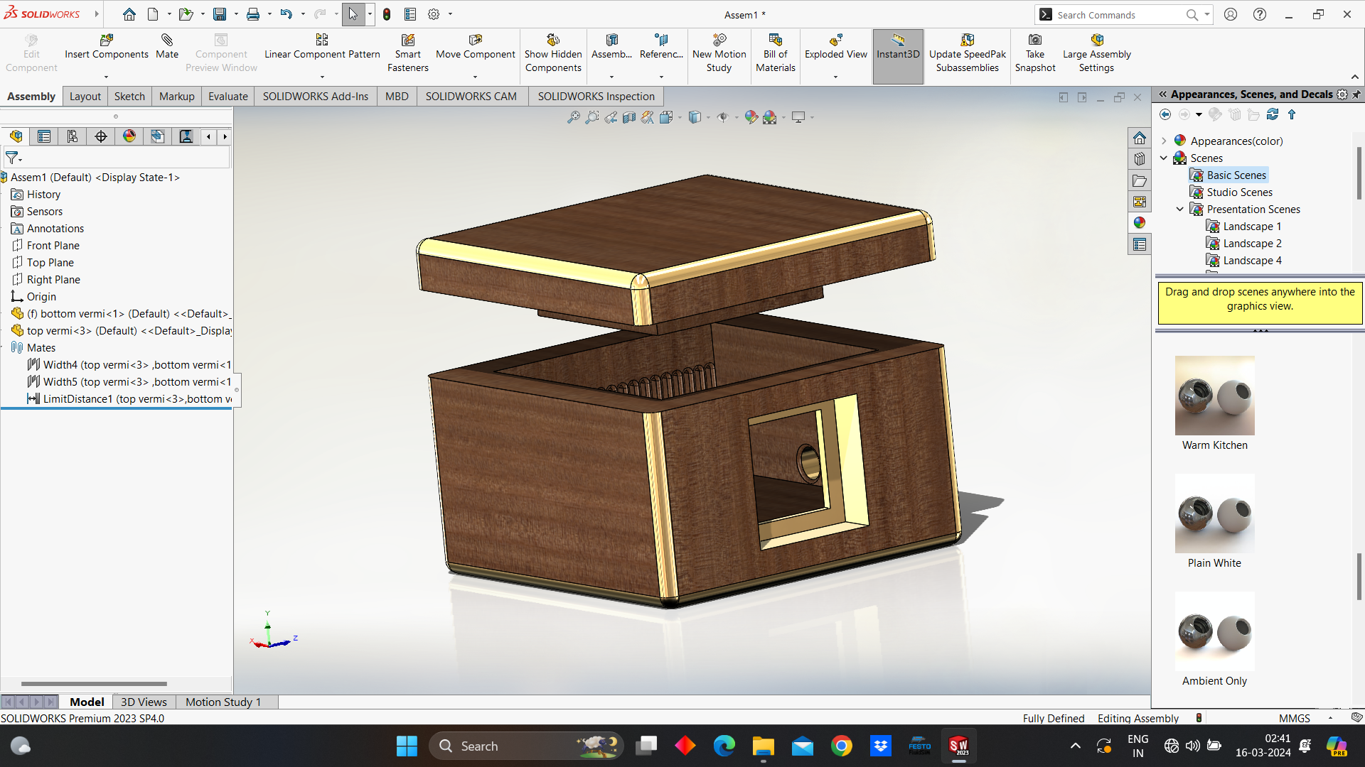
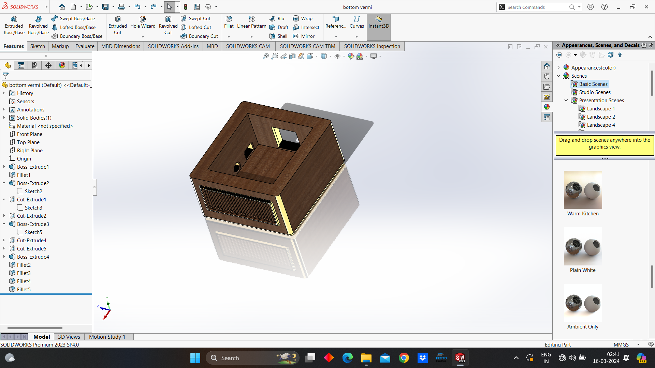
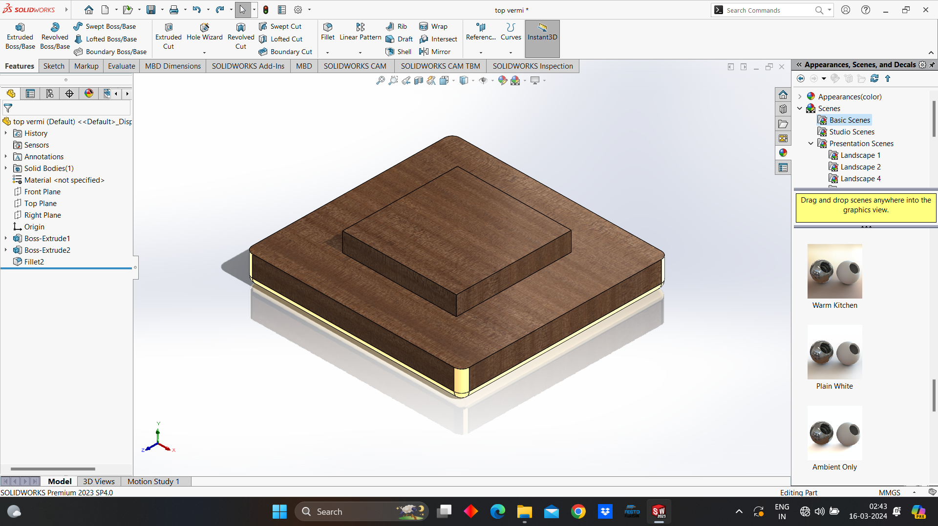
14th March,2024
Vermi system Solidworks

